Slide 1
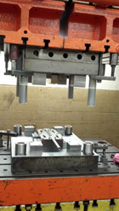
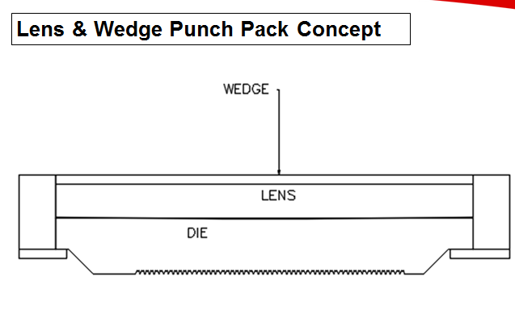
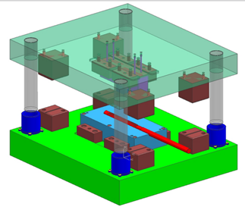
Cut and Coin updates 27 JAn16
Quoted for Tesla- waiting for decision
Currently costing for Chrysler W
New “Lens Adjustmet” being added to upper die
Will allow for easy ramp adjustments
Test parts awaiting stand availability

Slide 2
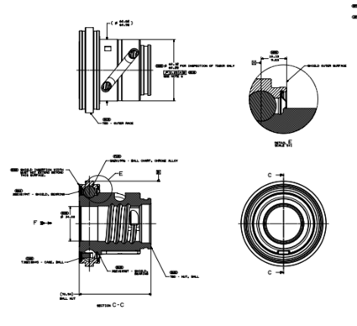
Integrated Bearing Assembly
Drawings complete
Request for prototypes issued 1/26
Jesse Heather working on prototype assembly fixtures
Will use T1XX as test platform
Need GSM support
Upside cost potential if we eliminate shields

Slide 3
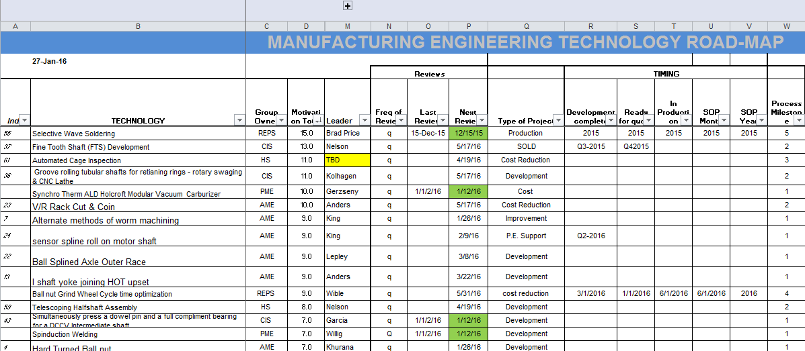
M.E Tech Roadmap
M.E. has started M.E. Tech Roadmap process
Remarkably similar to this forum
Focus on M.E. new technology
Includes HS and CIS
Some overlap with EPS tech roadmap
Updated scoring

